Slide 1

Building RAG Applications part-1
Instructor
Nikhil Pentapalli
Sr MLE Gen AI@ ADOBE

Slide 2


Table of Contents – RAG Part1
Intro to RAG(rag vs finetuning)
Embeddings and vector DBs
Pipeline discussion
Pain points in enterprise RAG
RAG prompt engineering?
Ragas evaluation
Demo

Slide 3
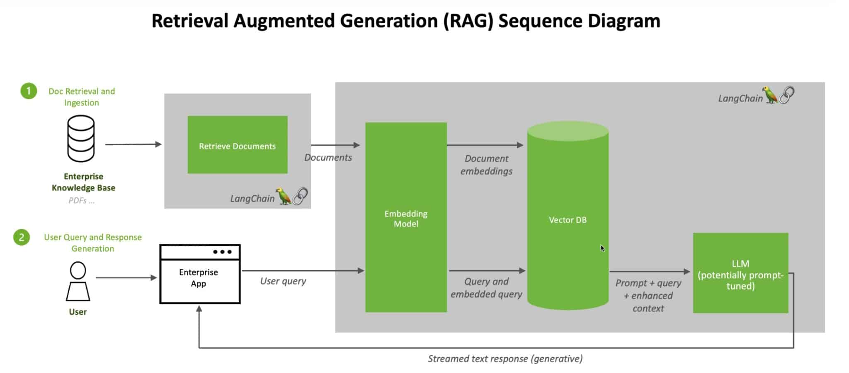
Intro to RAG

Slide 4
Rag vs finetuning
Feature | Fine-Tuning | RAG
Supports external knowledge sources | ✗ | ✓
Reduces hallucinations | ✓ | ✓
Requires specific domain training | ✓ | ✗
Suitable for dynamic or real-time data | ✗ | ✓
Provides interpretable outputs | ✗ | ✗
Efficient in resource consumption | ✗ | ✗
Fast to deploy | ✗ | ✗

Slide 5
Chunking Strategies
Techniques
Recursive Character Splitter
Sentence Splitter
Document Specific Chunking (MD,HTML..)
Code chunker/splitter
Semantic Chunking
LLM based Chunking

Slide 6
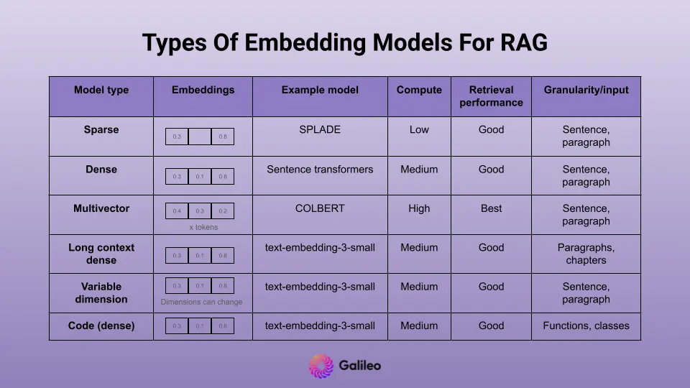
Embeddings and Vector DB’s
Difference between sparse and dense vs other embeddings
Credits : Galileo

Slide 7
Pipeline discussion
RAG based Q/A system pipeline
Let’s focus on:
Improving Retrieval
Hybrid Search
Some advanced search techniques in vector db’s
Rerankers and context improvements
Credits : Galileo

Slide 8
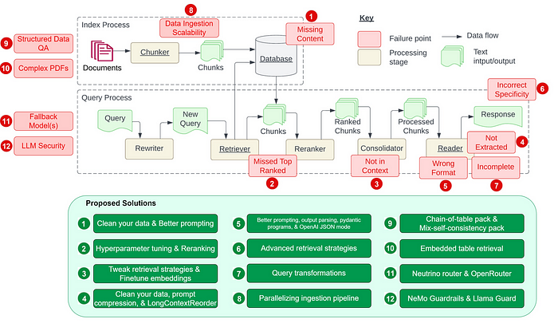
PAIN POINTS IN RAG SYSTEM

Slide 9
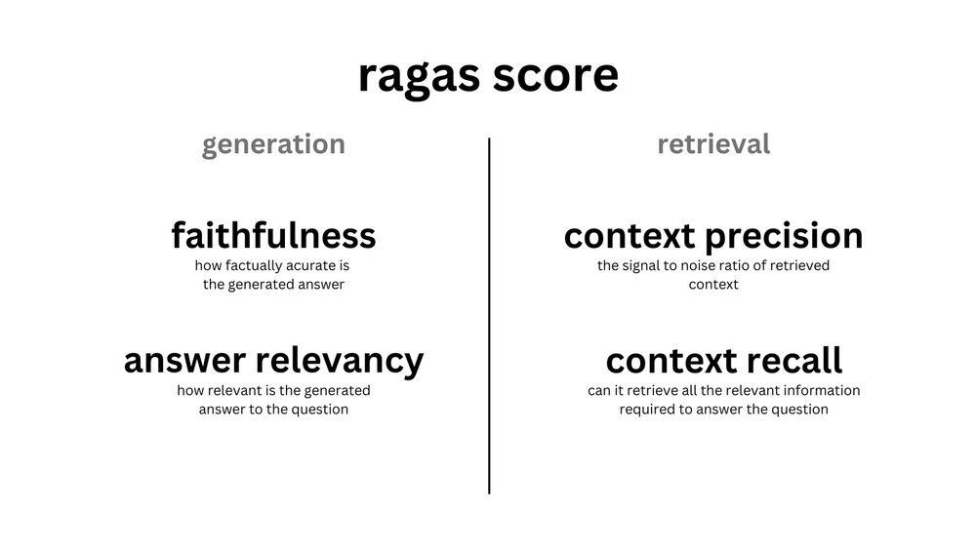
Ragas evaluation

Slide 10
Ragas evaluation
Faithfulness
Answer relevancy
Context recall
Context precision
Context utilization
Context entity recall
Noise Sensitivity
Summarization Score

Slide 11
Building RAG Applications part-2
Instructor
Nikhil Pentapalli
Sr MLE Gen AI@ ADOBE

Slide 12
Table of Contents – Part 2
Advanced and Latest RAG techniques
Multimodal rag and Colpali RAG
Langgraph/studio tracing/observability
Agentic RAG with example

Slide 13
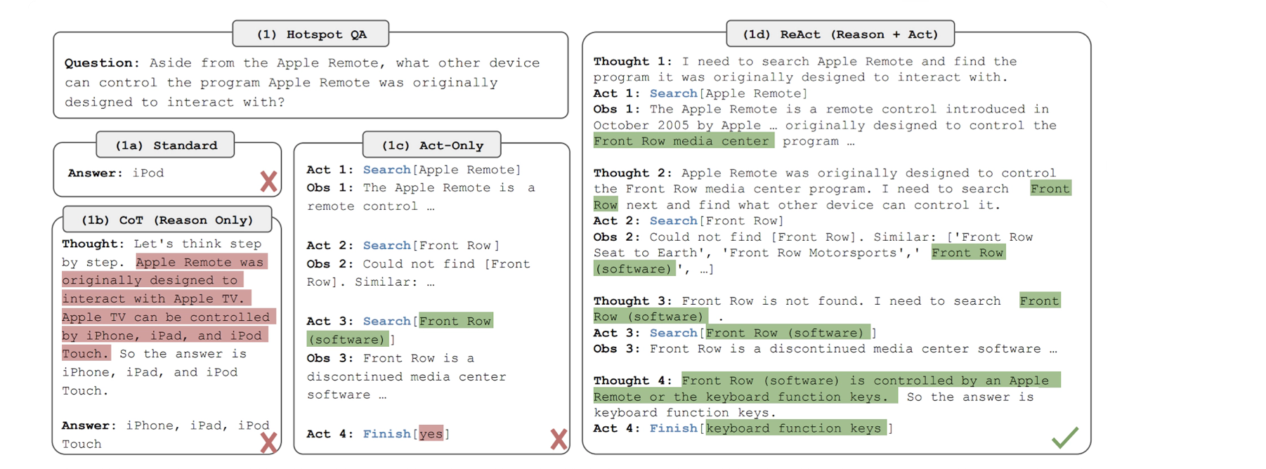
CoT , ACT and ReACT

Slide 14
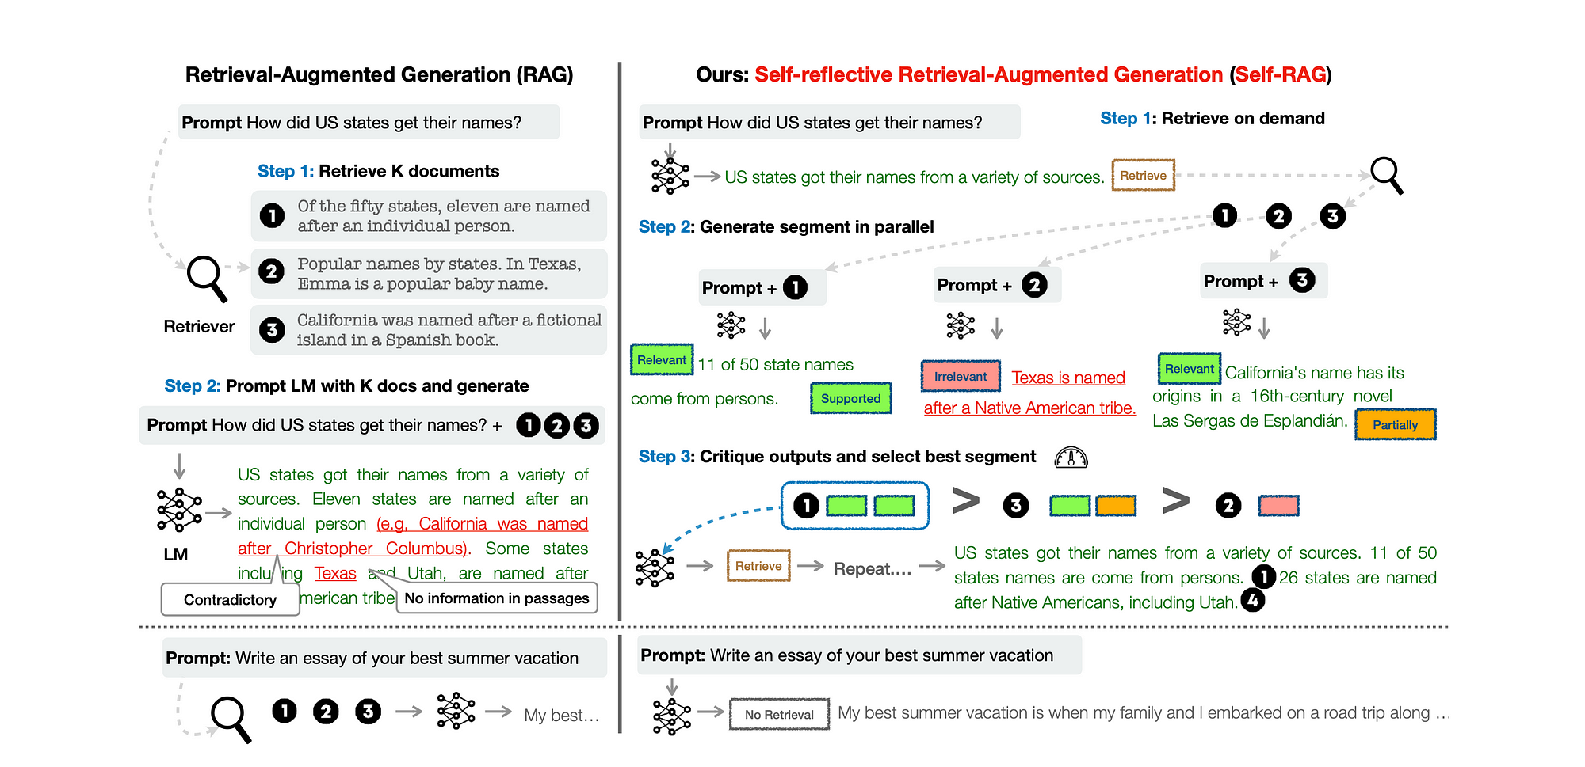
SELF RAG

Slide 15
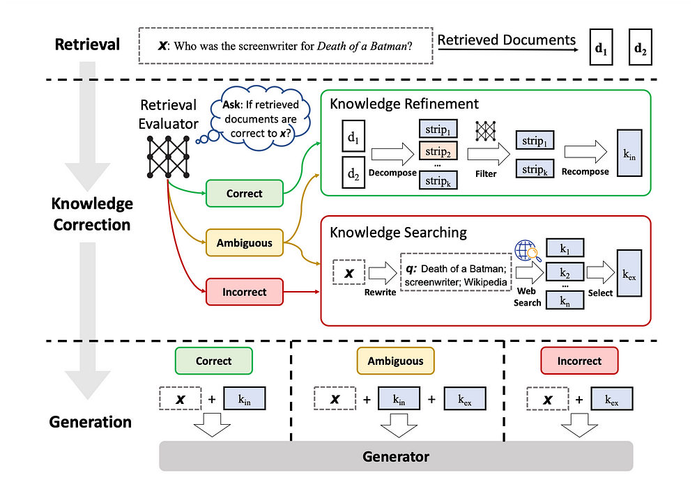
CORRECTIVE RAG(CRAG)

Slide 16
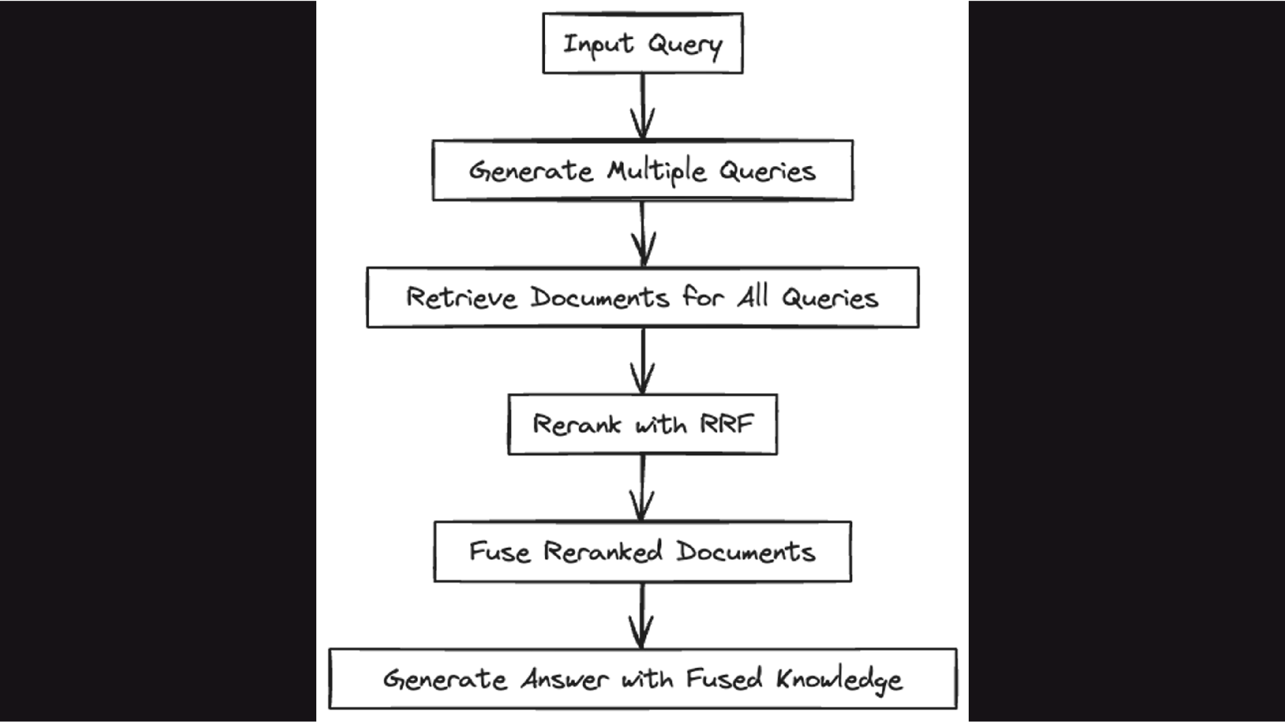
RAG FUSION
template = """You are a helpful assistant that generates multiple search queries based on a single input query. \n Generate multiple search queries related to: {question} \n Output (4 queries):"""

Slide 17
Advanced and Latest RAG techniques
Feature | Self RAG | Corrective RAG | RAG Fusion
Overview | Enhances LM's quality and factuality through retrieval and self-reflection. Uses special tokens for adaptive retrieval and critique of its own generations. | Improves robustness of generation with a lightweight retrieval evaluator and a decompose-then-recompose algorithm for document refinement. Utilizes large-scale web searches for augmentation. | Combines RAG and Reciprocal Rank Fusion (RRF) by generating multiple queries, reranking with reciprocal scores, and fusing documents and scores for more accurate and comprehensive answers.
Key Mechanism | Fine-tuned with reflection tokens and critique tokens for on-demand retrieval and generation quality assessment. | Employs a retrieval evaluator to assess document quality and triggers actions (Correct, Incorrect, Ambiguous) based on confidence scores. | Generates multiple queries from the original query, reranks documents using RRF, and fuses them for the final output.
Advantages | Increases factuality and versatility of responses. Adaptable to diverse task requirements. | Significantly improves the performance of RAG-based approaches in both short- and long-form generation tasks. | Provides more accurate and comprehensive answers by contextualizing the original query from various perspectives.

Slide 18
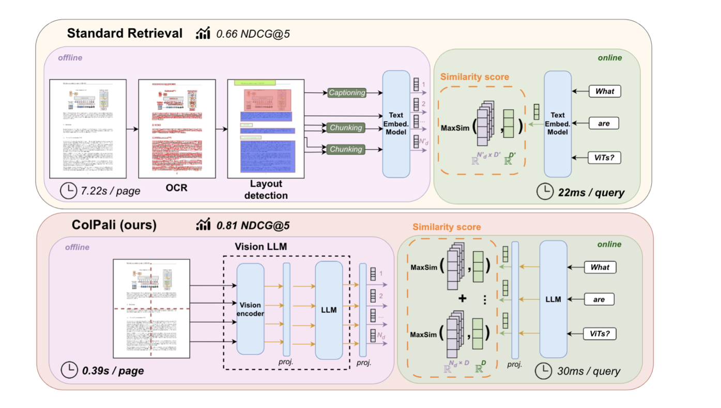
Colpali RAG

Slide 19
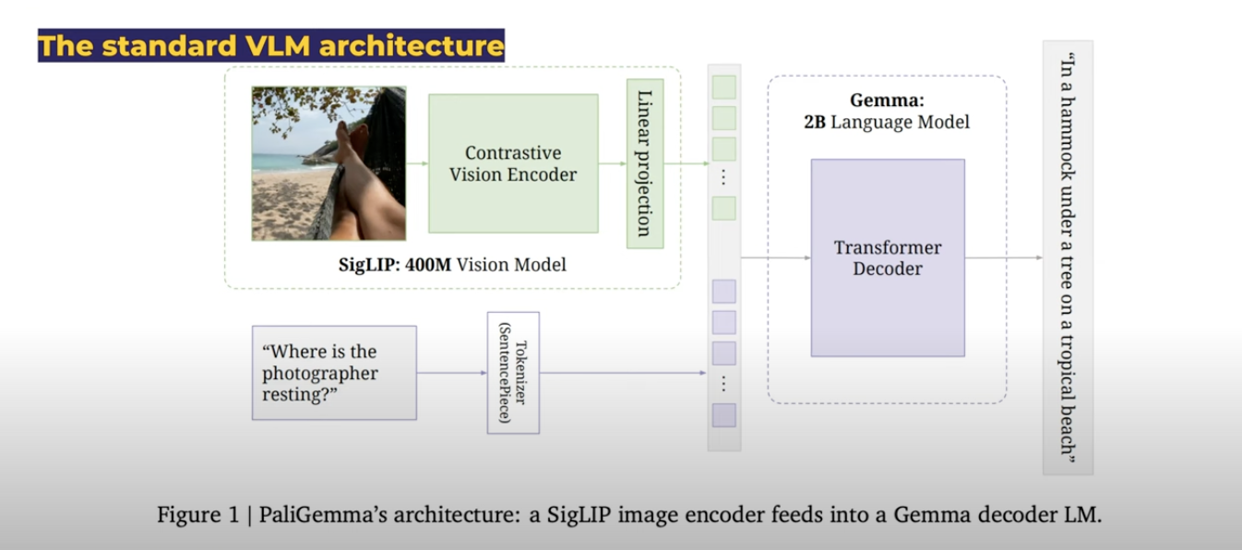
Pali Gemma Architecture

Slide 20
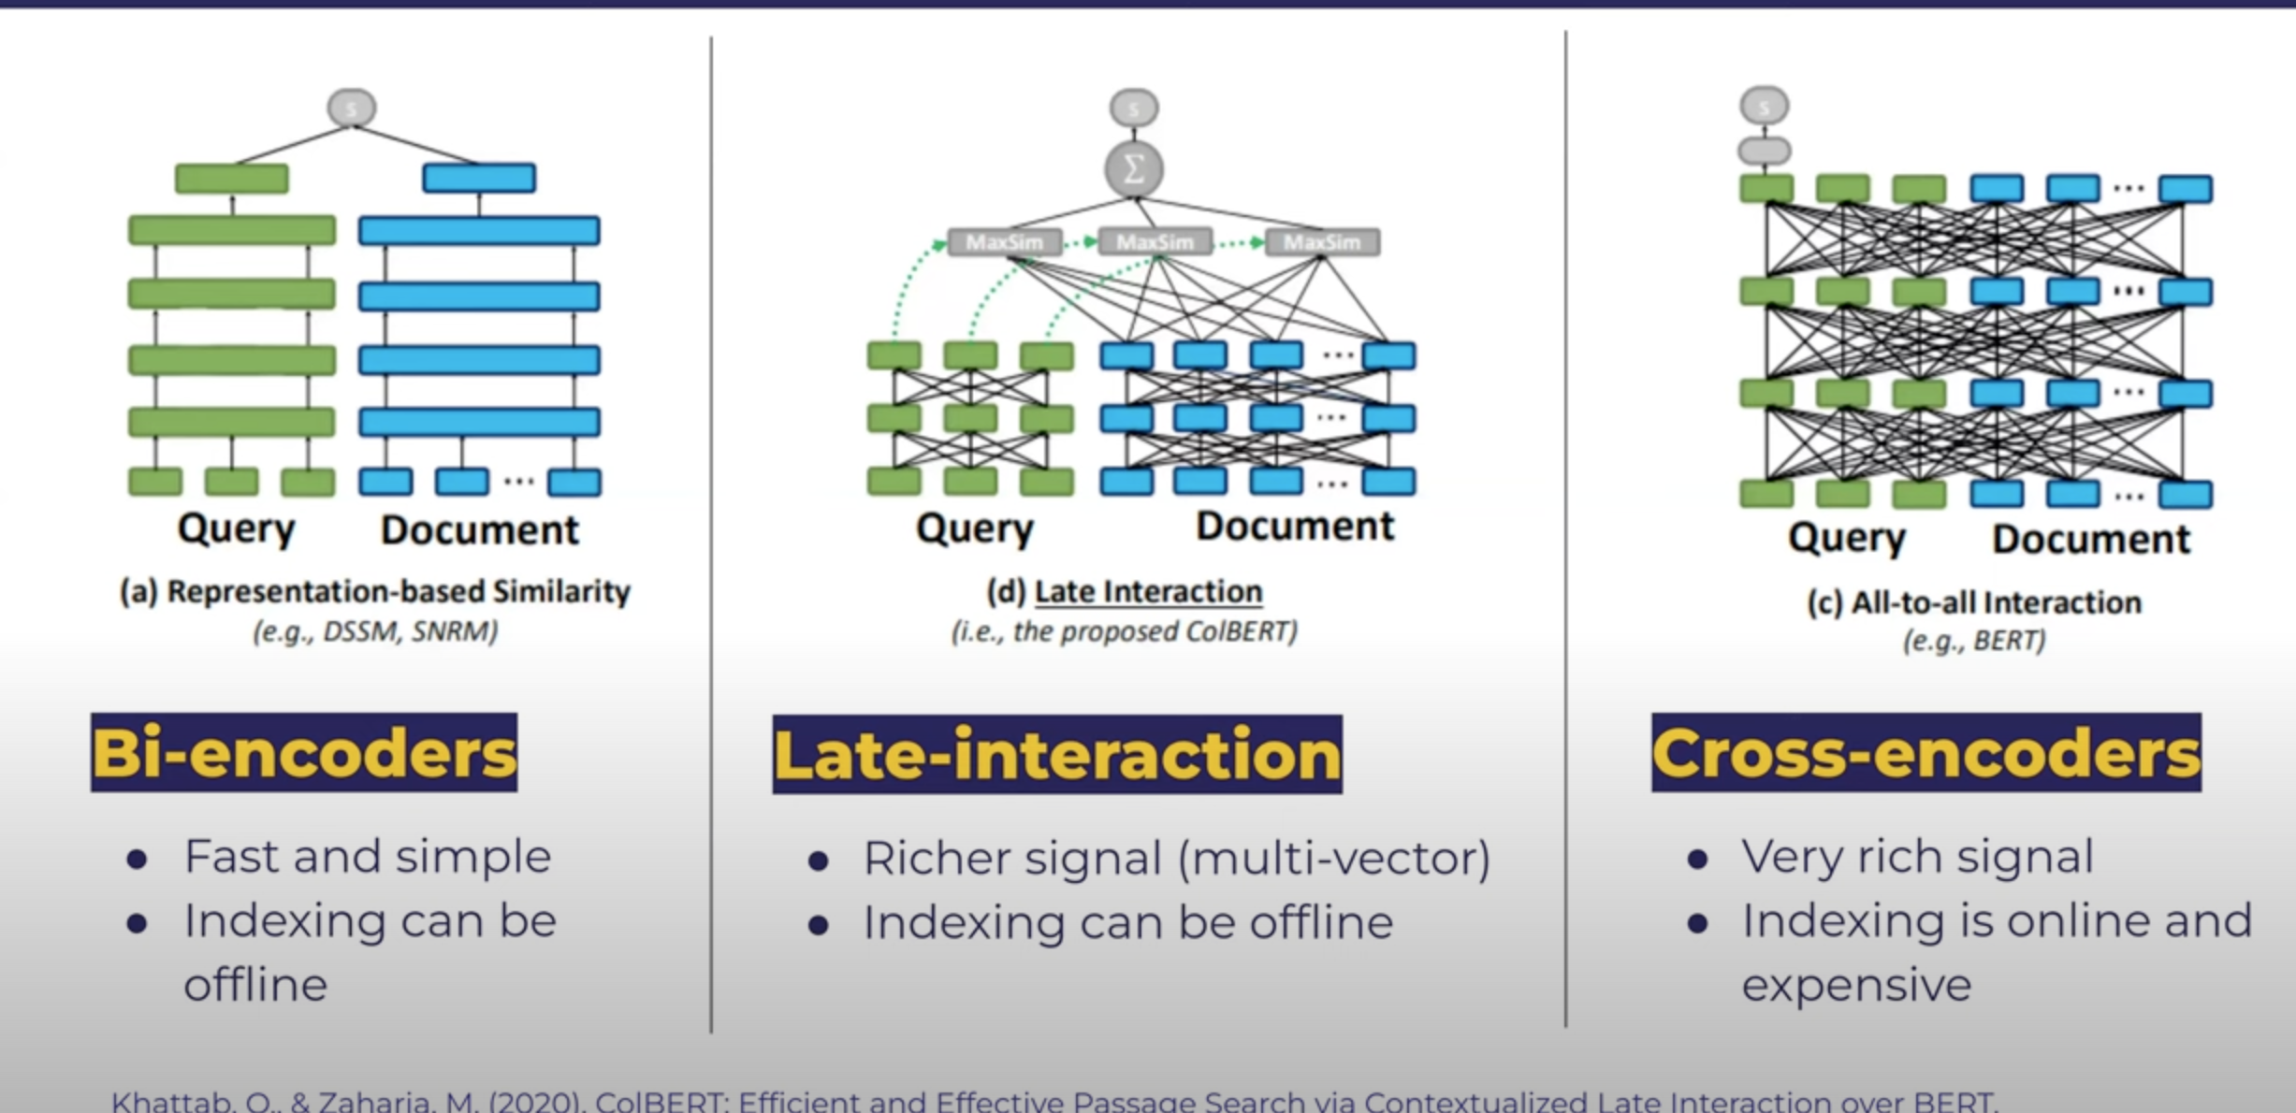
Colpali RAG

Slide 21
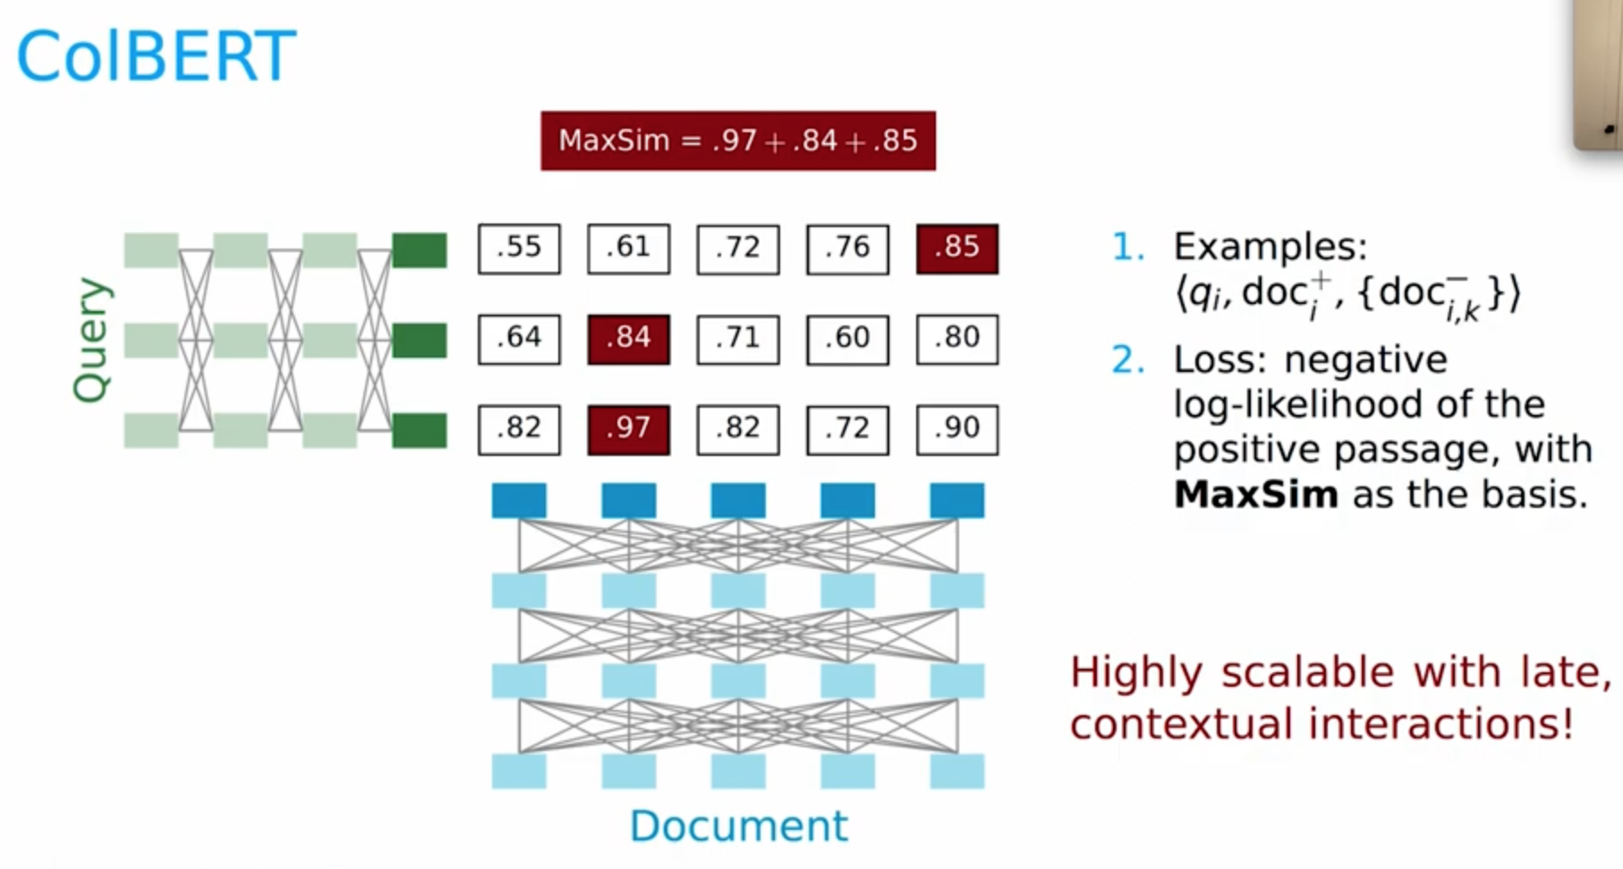
ColBERT

Slide 22
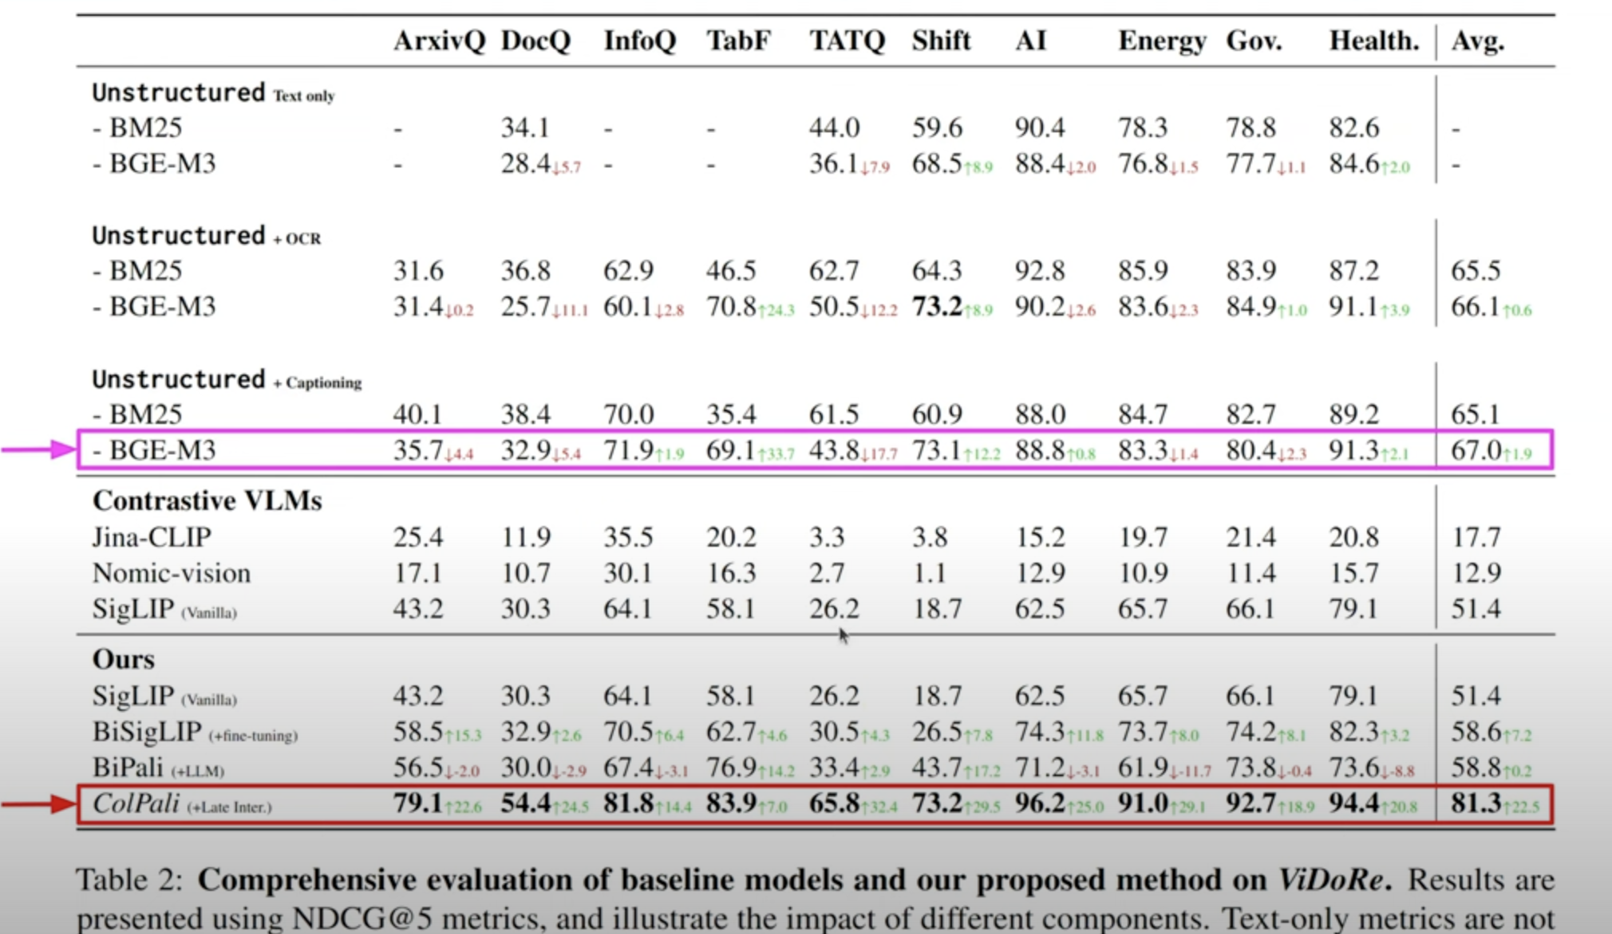
Colpali RAG

Slide 23
Colpali RAG Demo
ColPali Demo

Slide 24
Things to consider while building agent!
1. Tools 2. Reasoning 3. Flow 4. Control 5. Verification 6. Stop Condition 7. Evaluation

Slide 25
Langgraph and basic AI agent building and tracing and evaluation
Demo on Langchain agent project structure
Spin up Langgraph locally and run sample project
Adjust the inputs ,vars and run and trace
Inbuilt and custom metrics discussion
Scaling

Slide 26
Agentic Rag (Demo on GPT researcher)
Colab Notebook

Slide 27
Resources
Standford ColBERT ColPali by authors
Sample agentic AI architecture
Langgraph studio SelfRAG, CRAG and RAG Fusion
ColPali Paper Arxiv

Slide 28

Thank You!
Connect On Linkedin
Twitter(X)
Data Resources

